Slide 1
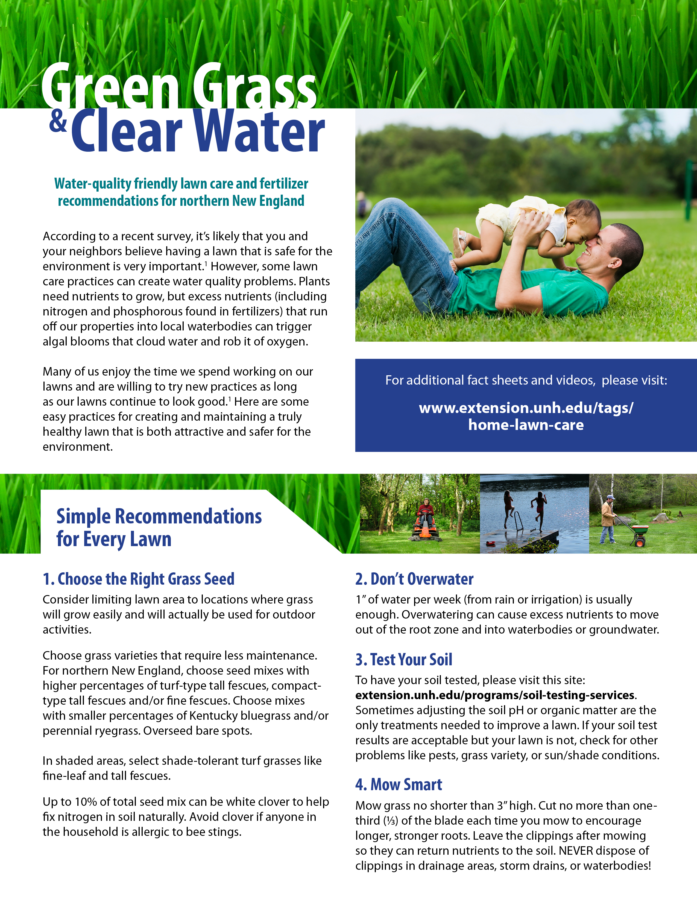
Town of Kingston, New Hampshire
.

Slide 2
