Slide 1
Town of Kingston - Fire Station Summary of PFAS Investigation May 8, 2023
Anne Sheehan, PG
Steve Zemba, PhD, PE (in MA)

Slide 2
Agenda
Safety Share
Basic Hydrogeology
What are PFAS
Summary of Sampling Results
PFAS Composition
Site Conceptual Model
Permanent Solution Options
Next Steps
Questions

Slide 3
Driving in the Rain
During a dry period, engine oil and grease build up on the road over time. When mixed with water from a new rainfall, the road becomes extremely slick.
What to watch out for:
Hydroplaning – Can occur at speeds as low as 30 mph and literally lifts your vehicle off the pavement!
Allow more time for Travel – Rushing equal's risk!
Brake Earlier with Less Force – Early warning for those behind you and increases stopping distance.
Turn on your headlights!
Defog your Windows
Watch for Pedestrians
Don’t use Cruise Control!
Don’t drive into or over running water.

Slide 4
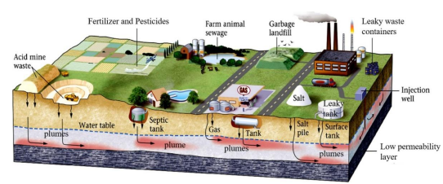
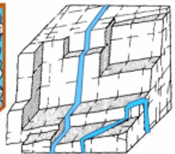
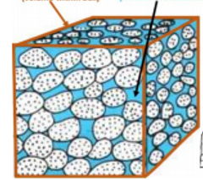
Basic Hydrogeology
Overburden
(sand, gravel, silt, clay)
Water Table
Bedrock
(fractures)
Overburden Well
Water between sand grains
Water in fractures
Notes:
Underground
overburden – made up of sand, gravel, silt, clay
bedrock – solid rock – but it has cracks or fractures
Groundwater
water in the spaces between sand grains or in the fractures of bedrock
Water Table
top of water underground
well fills with water – that is water table.
Overburden Wells – 20-50’ deep
Bedrock wells 100 to several hundred feet deep
Contamination gets on the ground, rain makes it soak down to the water table
Water moves underground – very slowly, goes downhill
Concentrations of contaminants decrease as groundwater moves further from source, composition can also change as contaminants degrade

Slide 5
Per- and Polyfluoroalkyl Substances - PFAS
Group of man-made compounds widely used in many common household and commercial products for decades.
Used as processing aid in making non-Stick cookware (e.g. Teflon®)
Surface protection for stain- or water-resistance
Carpets
Clothing (e.g., Gore-Tex®); and
Furniture;
Surface protection for food packaging:
Microwave popcorn bags;
Fast food wrappers; and
Pizza boxes;
Industrial processes; and
Some firefighting foams.
Septic Systems can be sources of PFAS

Slide 6
PFAS (continued)
Each source will have a different combination of PFAS compounds and the composition can change over time
New Hampshire regulates four PFAS in drinking water
Ambient Groundwater Quality Standard (AGQS)
Perfluorooctanoic acid (PFOA) 12 ng/L
Perfluorooctanesulfonic acid (PFOS) 15 ng/L
Perfluorononanoic acid (PFNA) 11 ng/L
Perfluorohexanesulfonic acid (PFHxS) 18 ng/L
ng/L is equivalent to a part per trillion (ppt)
EPA is proposing 4 ng/L for PFOA and PFOS!
Analyzed for 23 PFAS compounds in the groundwater samples.

Slide 7
Private Well Sample Results
A total of 92 private wells have been sampled since 2016
27 private wells have/had concentrations exceeding AGQS
6 have Point of Entry Treatment systems (POETs)
20 are receiving bottled drinking water
1 does not use the water for drinking
Evaluation of PFAS concentrations in wells sampled in at least 4 calendar years show generally stable to decreasing trends (7 wells)

Slide 8
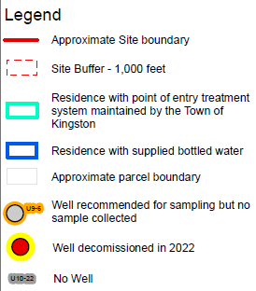
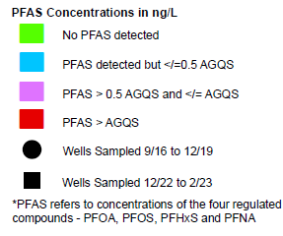
PFAS Sample Results
Notes:
Explain colors in relation to AGQS
Explain shapes
Explain outlines

Slide 9
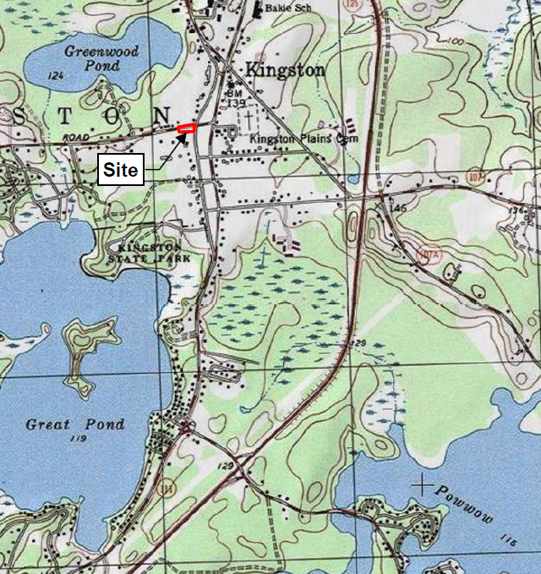
Groundwater Flow Direction
?
?
Notes:
Explain colors
Explain shapes
Number indicate concentration of PFOA
Contamination in BR and OB
Show 3 sources

Slide 10
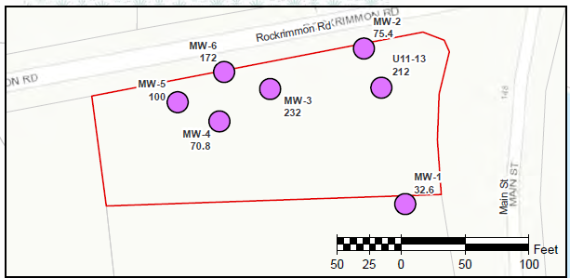
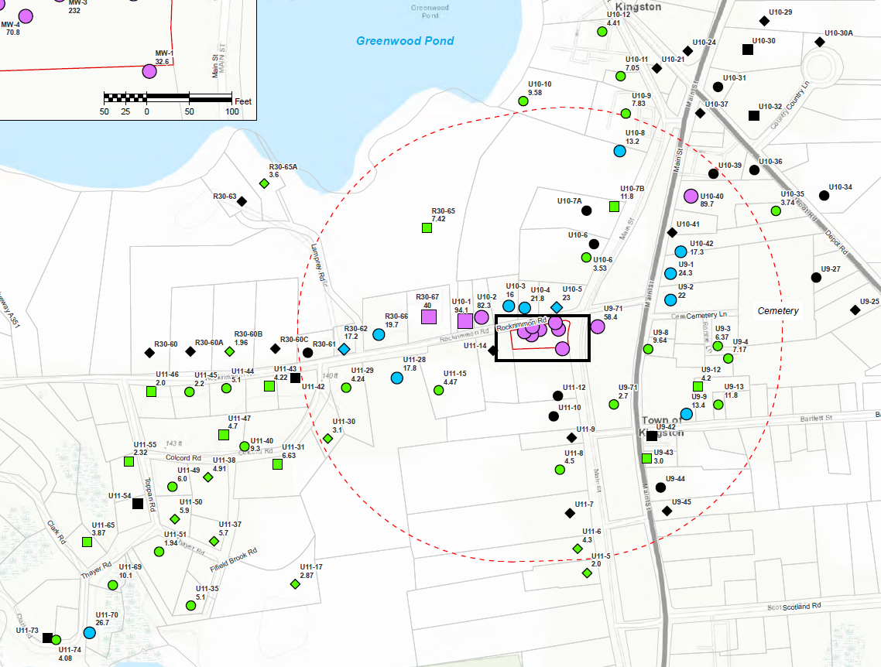
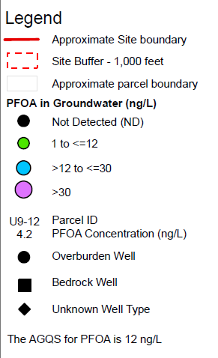
PFOA Results
Notes:
Explain colors
Explain shapes
Number indicate concentration of PFOA
Contamination in BR and OB
Show 3 sources

Slide 11
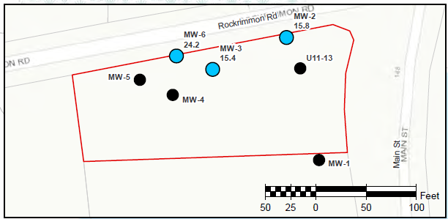
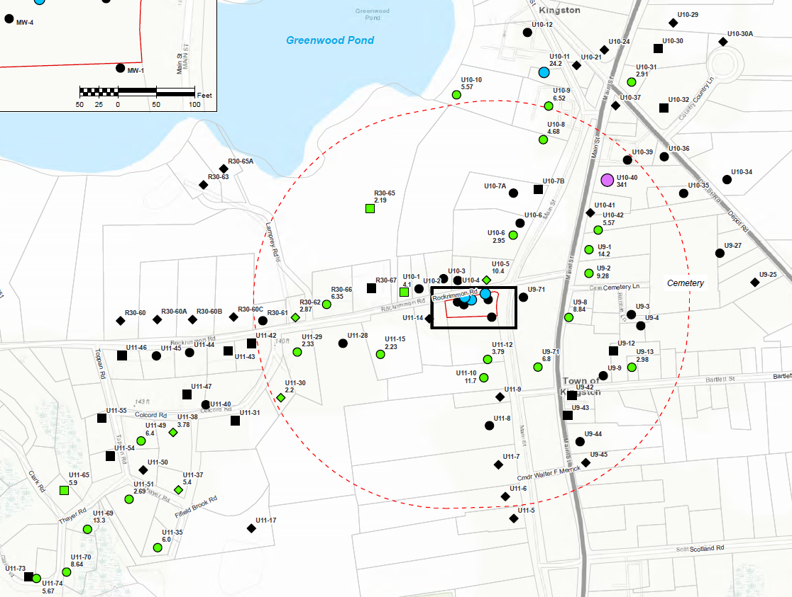
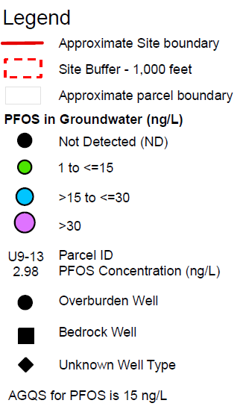
PFOS Results
Notes:
Explain colors
Explain shapes
Number indicate concentration of PFOS
Contamination in BR and OB – only greater than AGQS in OB
Show 2 sources

Slide 12
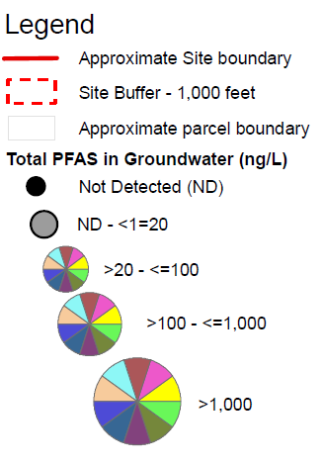
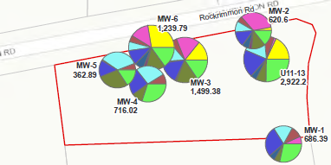
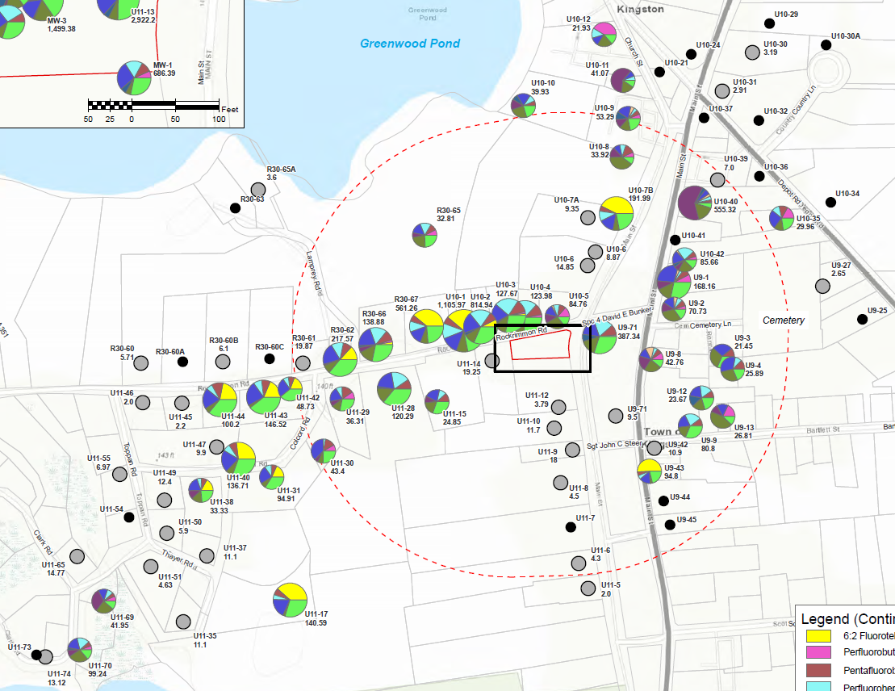
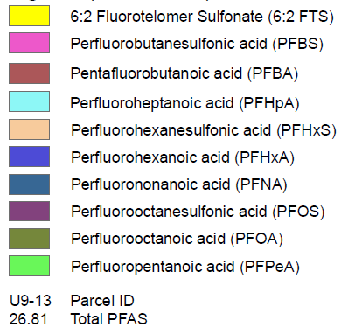
PFAS Composition
Notes:
Explain 10 PFAS
Colors – size of pie slice based on ratio of concentrations of each compound
Numbers sum of concentration of the 10 compounds
Size of pie relative to total concentration
Wells at fire station – logs of green and yellow
Wells along rockrimmon and toward great pond pretty similar
A bit different near great pond – could be different source, could be different due to distance from source
Other source north – higher concentrations
much more PFOS
likely upgradient of fire station
don’t know for sure which way groundwater flows up there

Slide 13
Conceptual Site Model
Sources:
Fire Station and possibly Kingston Plains - Fire fighting foam
North of Fire Station on east side of Main Street (near parcel U10-40) - Source?
Just north of Great Pond - Septic?
Contamination present in both overburden and bedrock groundwater
Groundwater flow from Fire Station is to the west then southwest toward Great Pond, flow in area north not well understood
PFAS Concentrations appear to be stable to decreasing
Extent of PFAS in groundwater is largely defined – additional sampling recommended in one area
Public is protected by Town providing drinking water (POETs or bottled water) where concentrations >AGQS and continued monitoring

Slide 14
Permanent Solution – Options and Rough Costs
Point of Entry Treatment Systems
$1.5 to $2.8 million to operate systems 20 years – does not account for inflation
Assumes 26 to 48 systems
Extend Water Line from nearby town (Exeter, Plaistow)
$6.8 to $9.1 million
For water line only, does not account for additional infrastructure that may be needed – pumping stations, storage tanks
Develop New Water Supply
$14.6 million (based on estimate from Town of Stratham)
Grants and loan options may be available from New Hampshire

Slide 15
Next Steps – Recommended Ongoing Monitoring
Annual Sampling - 27 locations with AGQS exceedances (drinking water being provided)
Semi-Annual Sampling – 7 locations where concentrations > 0.5 AGQS but < AGQS
One Time – 9 locations that are near wells with AGQS exceedances and either had detections but have only been sampled once or have not been sampled
Annual Report to New Hampshire Department of Environmental Services (NHDES)
Summarize sampling results
Evaluate concentrations and
Make recommendations to modify sampling, as needed

Slide 16
Next Steps – Additional Investigations
8 Soil samples for PFAS analysis in Kingston Plains where historically bonfires were put out with fire fighting foam
2-3 monitoring wells on Fire Station Property/Kingston Plains to monitor PFAS concentrations at source
Optional – 5 monitoring wells to better evaluate groundwater flow directions
Sample 3 source area monitoring wells for PFAS
Measure water levels at available monitoring wells
Prepare summary report of results
Rough Cost $24,400 to $38,000

Slide 17
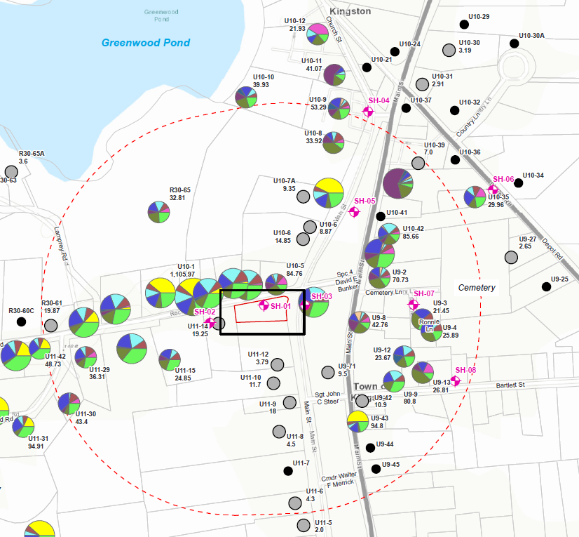
Additional Investigations
Soil Samples
Notes:
Explain 10 PFAS
Colors – size of pie slice based on ratio of concentrations of each compound
Numbers sum of concentration of the 10 compounds
Size of pie relative to total concentration
Wells at fire station – logs of green and yellow
Wells along rockrimmon and toward great pond pretty similar
A bit different near great pond – could be different source, could be different due to distance from source
Other source north – higher concentrations
much more PFOS
likely upgradient of fire station
don’t know for sure which way groundwater flows up there

Slide 18
Next Steps – Groundwater Management Zone
Apply for Groundwater Management Permit (GMP)
Control use of groundwater within Groundwater Management Zone (GMZ) – through placement of deed restrictions on affected properties
Implement measures to restore groundwater quality
Required monitoring and reporting
Evaluate effectiveness of remedial measures
Renew GMP every five years

Slide 19
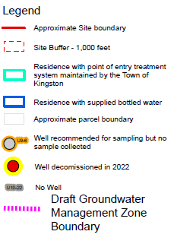
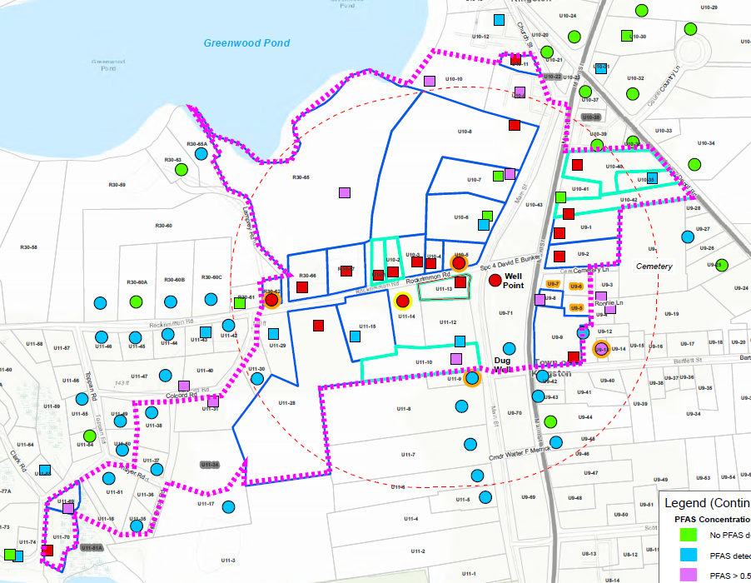
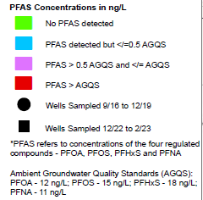
DRAFT Groundwater Management Zone

Slide 20
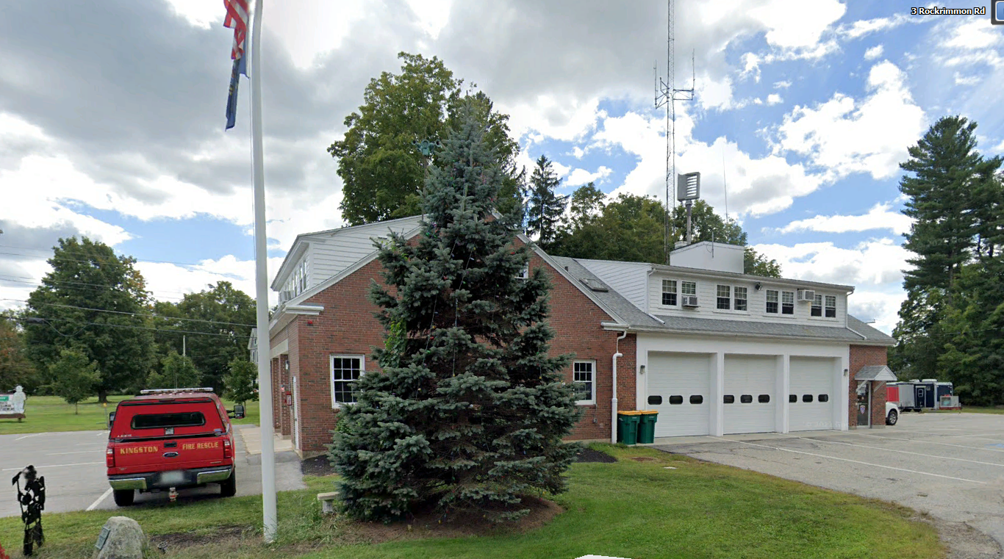
Questions
Anne Sheehan, PG
Asheehan@sanbornhead.com
Steve Zemba, PhD
Szemba@sanbornhead.com

Slide 21
Extra Slides

Slide 22
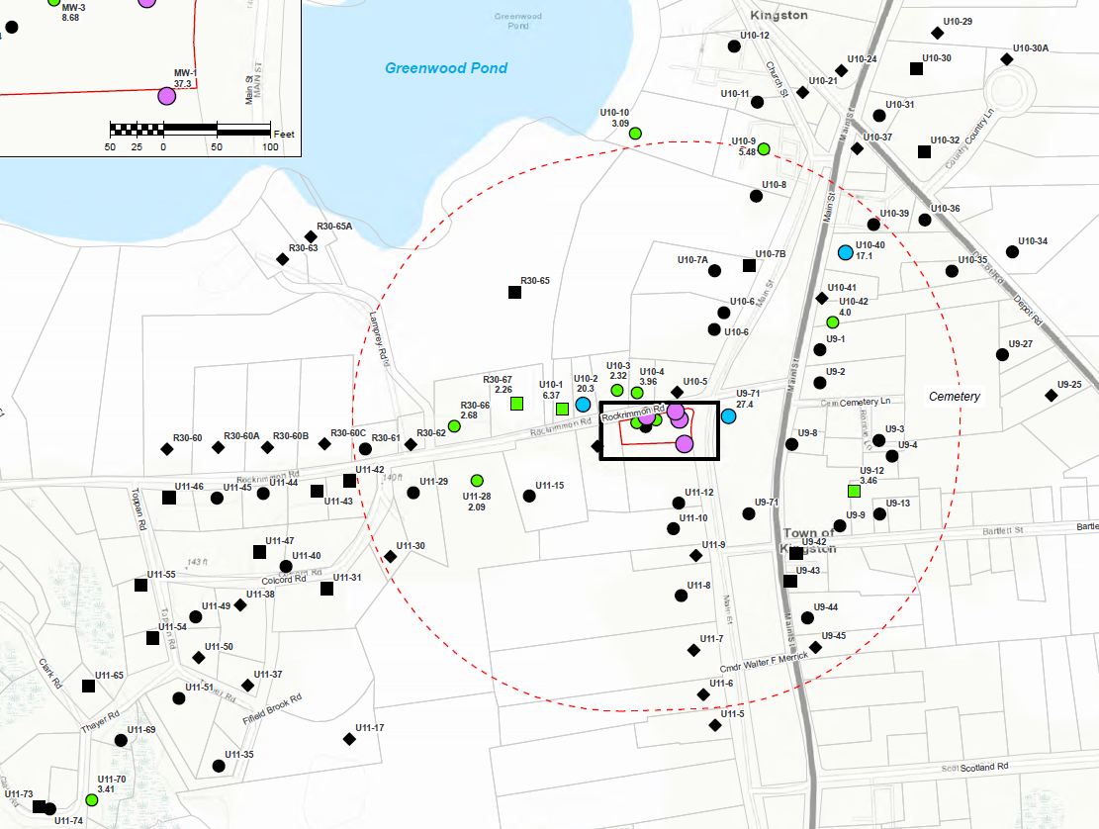
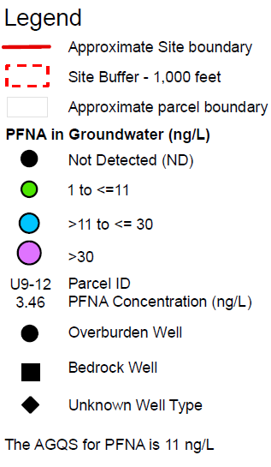
PFNA Results

Slide 23
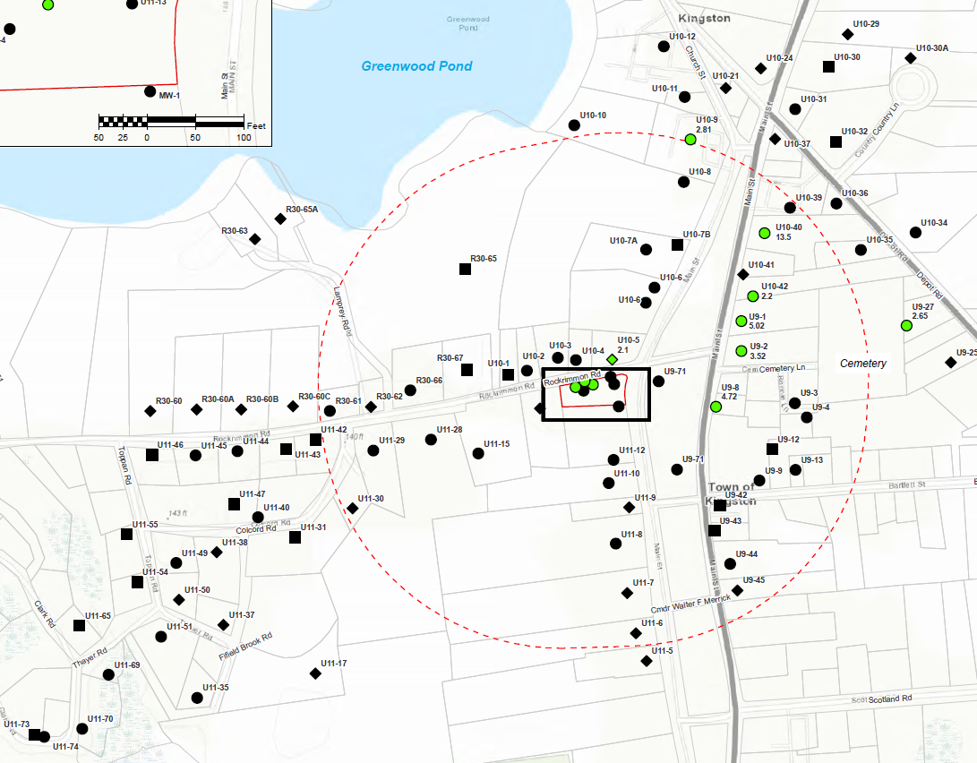
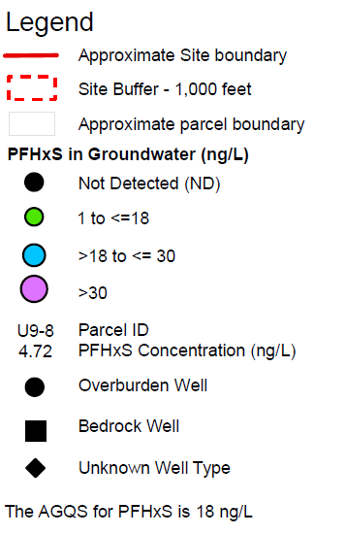
PFHxS Results

