Slide 1
Kingston Roads 2023 and Beyond
Kingston Public Works
15May2023

Slide 2
Agenda
Our Roads
Current Practice
Pavement Preservation vs. Paving
Asphalt Processing
Existing and Proposed Treatments
Town Route Map
2023 Work Proposal
Questions

Slide 3
Our Roads
122 Lane Miles of Road
Typically, a “worst first” approach by geographical area
Shim and Overlay as the primary method of paving
Asphalt has gone from$61/T in 2020 to $82/T in 2022 (35% increase)
Average lifespan of 10-15 years
Alternative pavement preservation techniques can extend this by many years

Slide 4
Non-Paving work
Tree Trimming
Ditching
Culvert work
Undermined area restoration
Engineering and Permitting
And More….
Striping
Shoulder gravel
Driveway leveling

Slide 5
Shim and Overlay
Restore road profile (does not need to be full width)
Wheel rutting
Improve roadway drainage
Aged patches
Edge repairs
Minor depressions
Raveled pavement

Slide 6
Life Cycle Costs of Pavement- $1 vs. $9

Slide 7
They don’t make it like they used to….

Slide 8
Truck Mounted Shoulder Gravel Attachments:
-Can reinforce worn or washed-out areas to minimize failure on road edges.
-$7,000 cost for two trucks
-Would have saved $21,000 on last years paving and been done immediately.

Slide 9
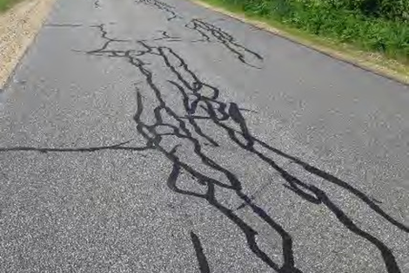
Crack Sealing
Seals moisture out of existing pavement and base materials
Helps to prevent additional cracking and pavement distress caused by moisture damage
Significant improvements when combined with other treatments
Biggest ROI for holding current conditions

Slide 10
Asphalt Hot Box
Allows for repair work in multiple locations at different times.
Millings can be recycled
Pot hole repairs that last any time of year

Slide 11
Conventional Chip Seal
Waterproofs and seals pavement, including small cracks and imperfections
Protects existing surface from traffic wear and improves skid resistance
Quick construction process minimizes traffic disruption
Single chip seal approximately 1/3 the cost of shim and overlay

Slide 12
Asphalt Rubber SAM
Waterproofs and seals pavement, including small cracks and imperfections
Highly resistant to reflective cracking
Protects existing surface from traffic wear and improves skid resistance
More expensive than chip seal but better for heavier traffic
Approximately 2/3 the cost of shim and overlay

Slide 13
Town Route Map

Slide 14
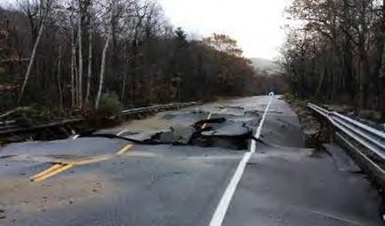
2023 Proposed Work- Shim and Overlay
Green Route:
Grandview Terrace
Pheasant Run
Red Gate Dr
Fieldstone Dr
South Rd
Crawley Falls Rd.

Slide 15
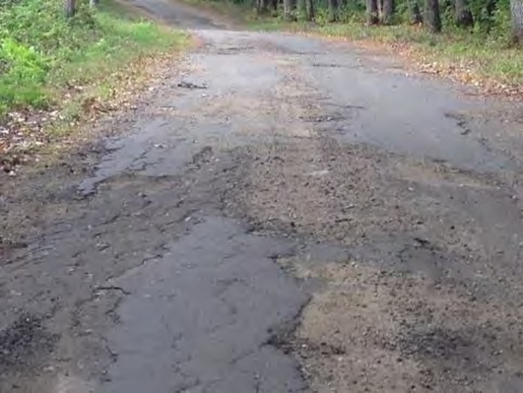
2023 Proposed Work- Shim and Overlay
Grey Route
Colby Rd
Rams Way
Beaver Pond Rd
Hemlock Rd
Morning Dove
Robin Ln
Doore ****

Slide 16
2023 Work- Chip & Crack Seal
Conventional Chip Seal
Jericho Dr.- Double Chip
Williams Path
Crack Seal
All main roads (excluding New Boston).
Brown, Red, Green routes by priority

Slide 17
Questions?

